Slide 1
Evaluating ROVIO and OKVIS – Two Visual-Inertial Odometry Implementations
Julian Surber
Semester Thesis
Supervised by Margarita Chli & Lucas Pinto Teixeira

Slide 2
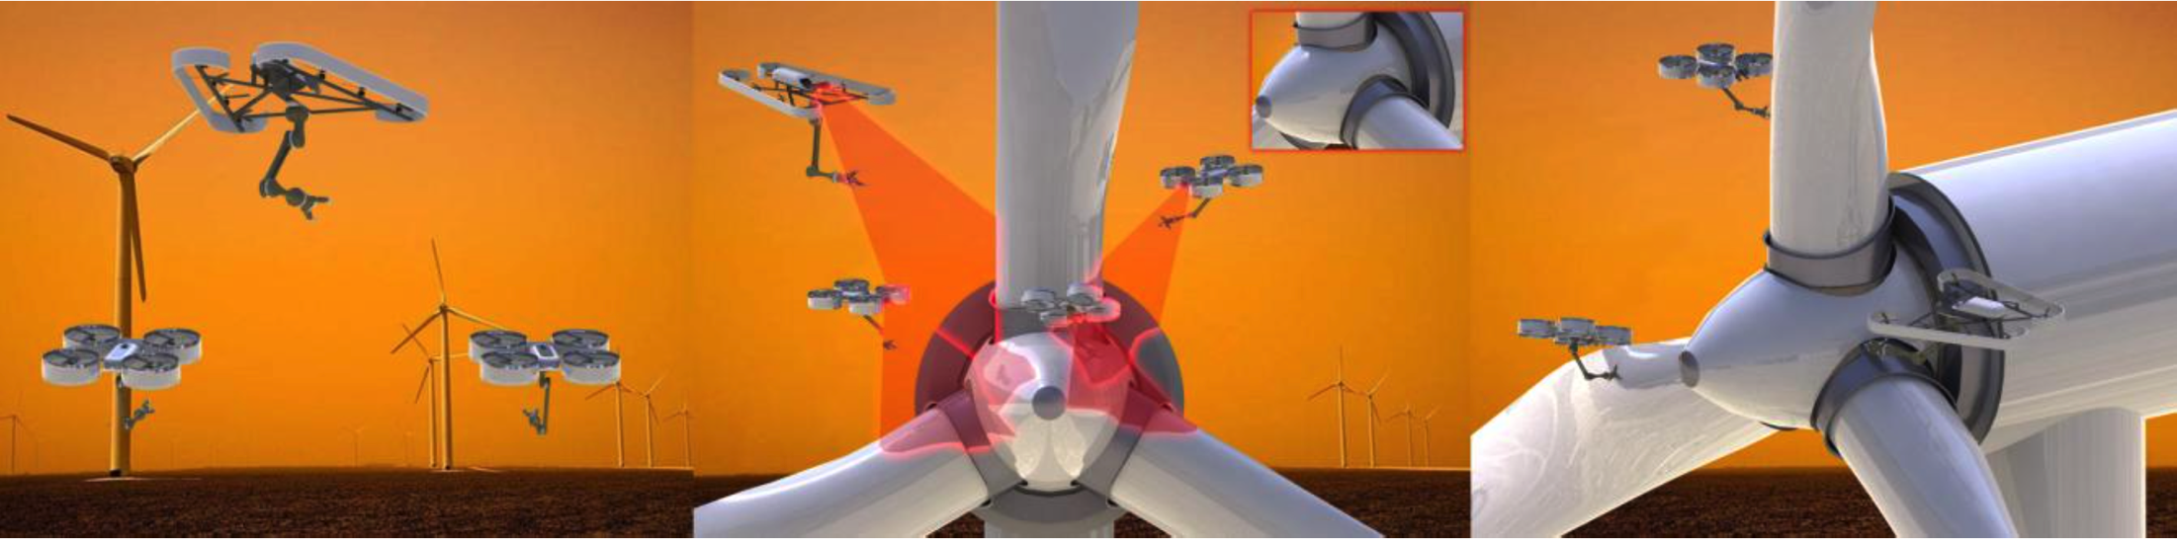
Intro
One key challenge: Single Robot Localization
Global and Local
Visual-Inertial Odometry
Complementary Properties
Lightweight
Cheap
Passive, onboard sensors

Slide 3
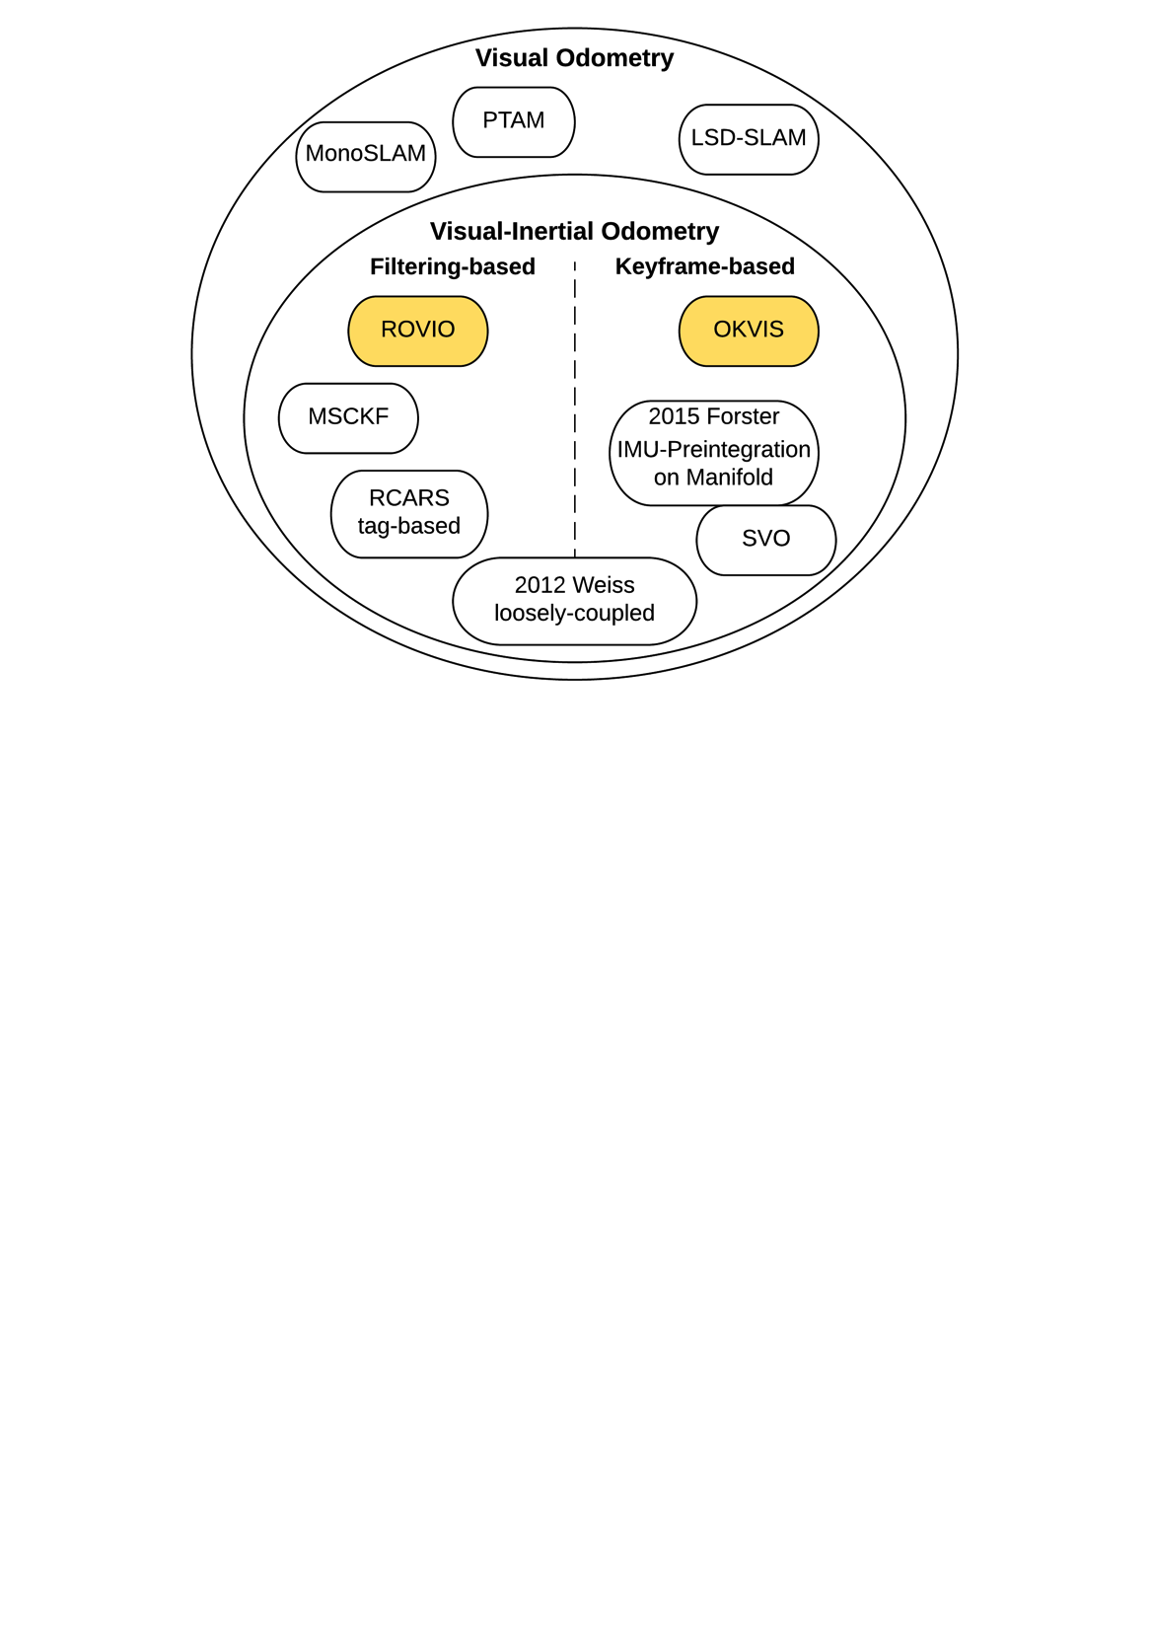
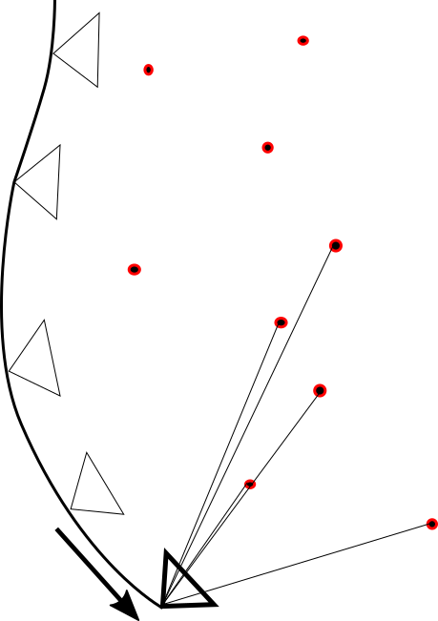
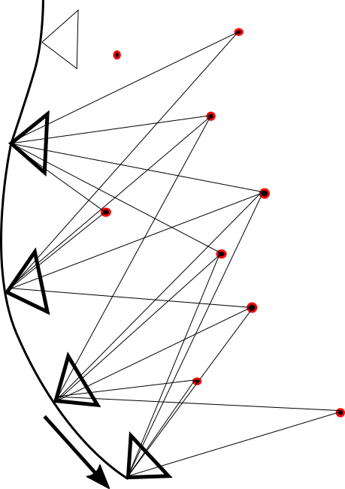
Overview

Slide 4
ROVIO – Robust Visual Inertial Odometry Using a Direct EKF-Based Approach
State Propagation with IMU (200 Hz)
Position, Velocity, Attitude, IMU Biases, IMU-Camera Extrinsics, Features (Bearing Vector and Distance to Frame)
Update with Cameraframes (20 Hz)
Feature Detection with Fast Corner Detector
Multilevel patch Features
Direct Intensity Error
„Small“ number of Features

Slide 5
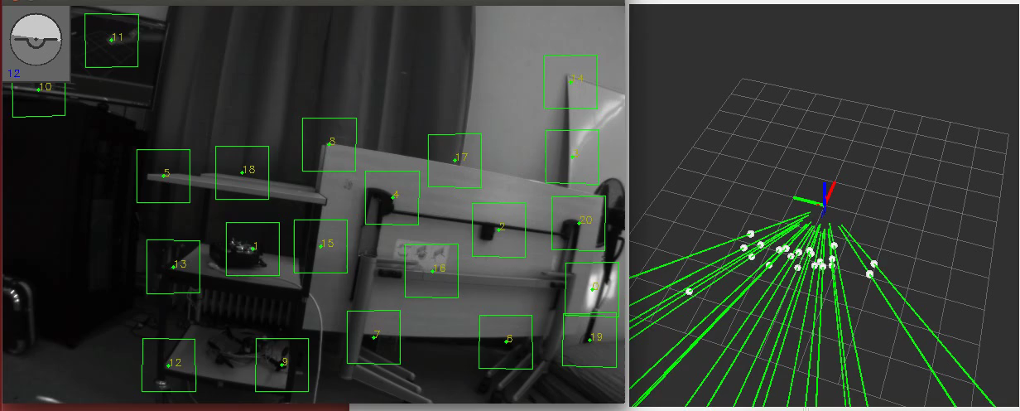
ROVIO – Robust Visual Inertial Odometry Using a Direct EKF-Based Approach

Slide 6
OKVIS – Optimal Keyframe-Based Visual Inertial SLAM
Nonlinear optimization
Position, Velocity, Attitude, IMU Biases, Landmarks
Propagation with IMU
Multiscale Harris corner detector
Brisk descriptor aligned with gravity
Marginalization: Keep only several Keyframes and Landmarks
„Large“ number of Features

Slide 7
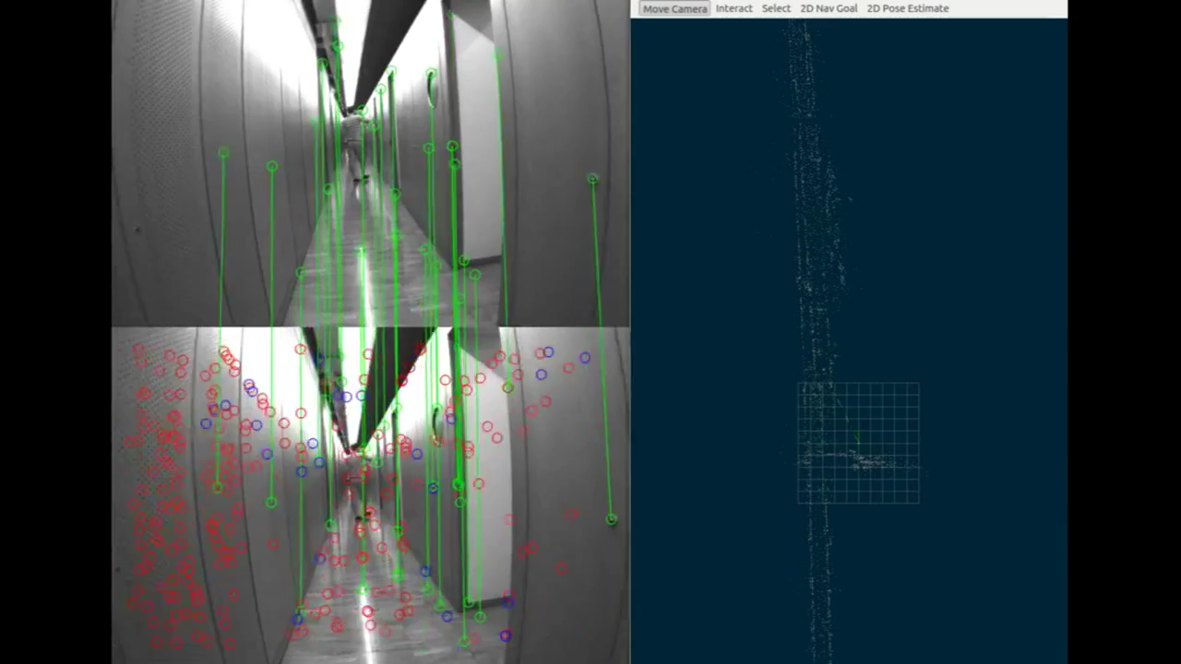
OKVIS – Optimal Keyframe-Based Visual Inertial SLAM

Slide 8
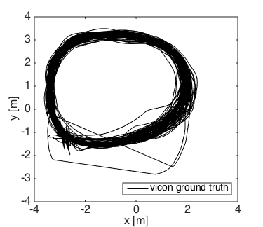
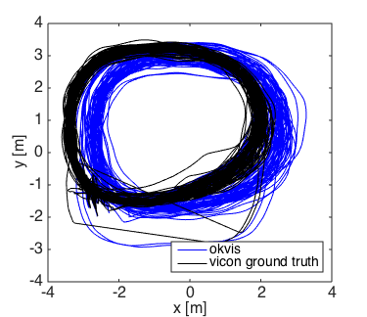
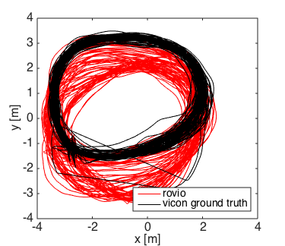
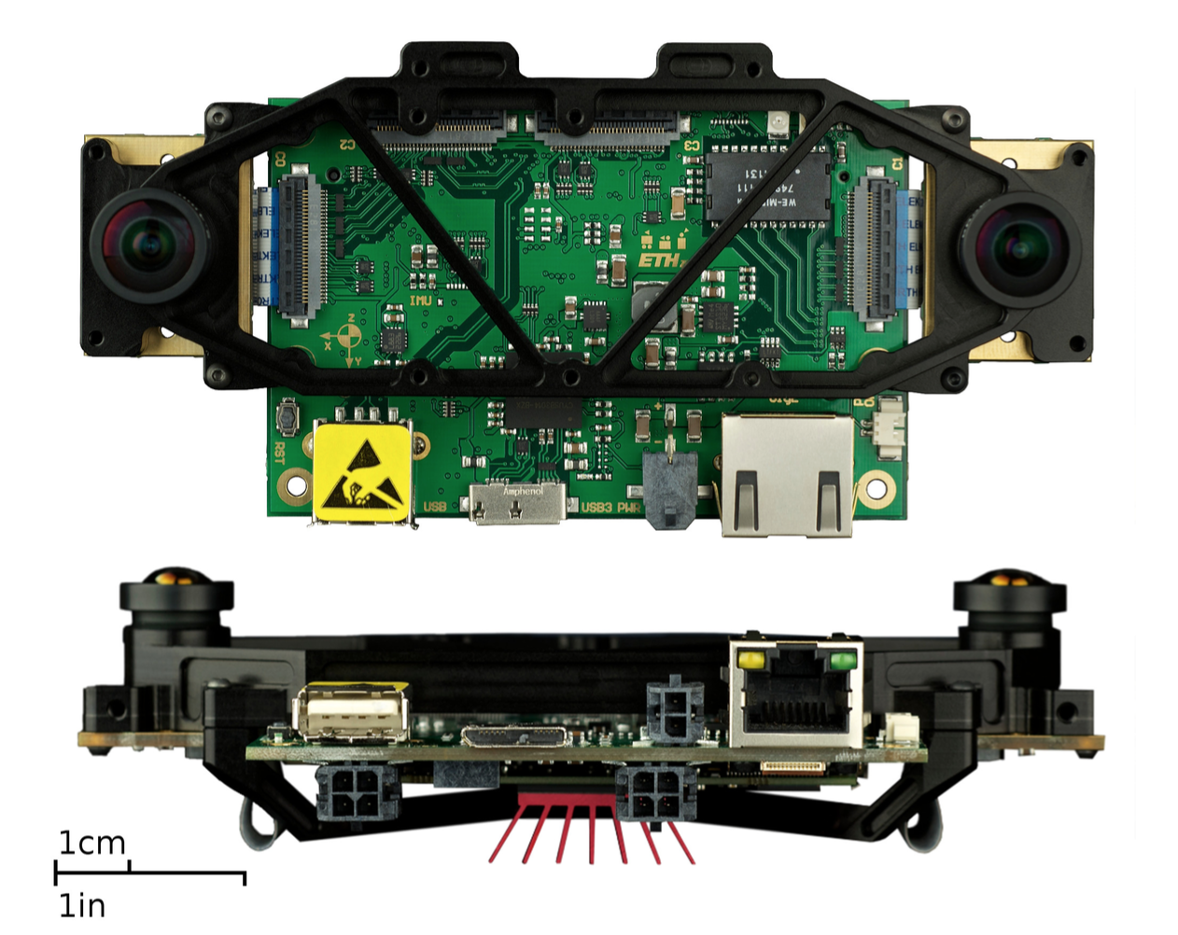
Comparison
VI Sensor
Distance 1200 m, handheld, 100 Loops
Dynamics: 2.5 m/s, 3 rad/s

Slide 9
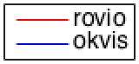
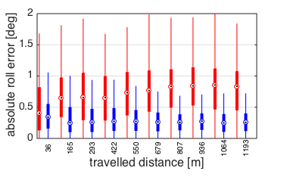
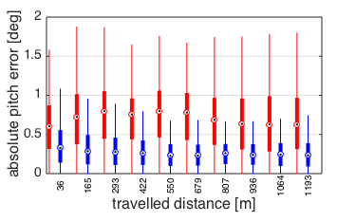
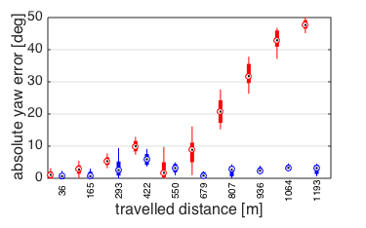
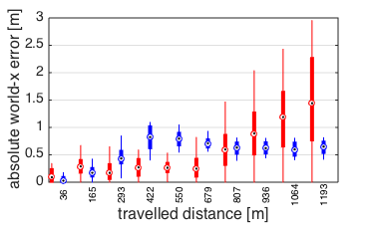
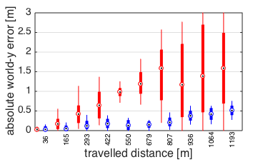
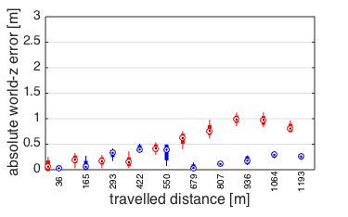
Global Accuracy – separated axes

Slide 10
Global Accuracy
Yaw Drift of Rovio 10 times higher over 1000 m
World-z Drift of Rovio 3 times higher over 1000 m

Slide 11
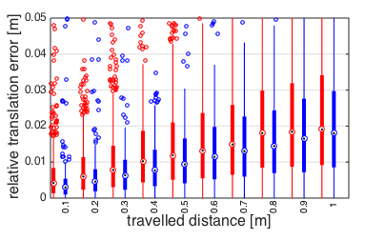
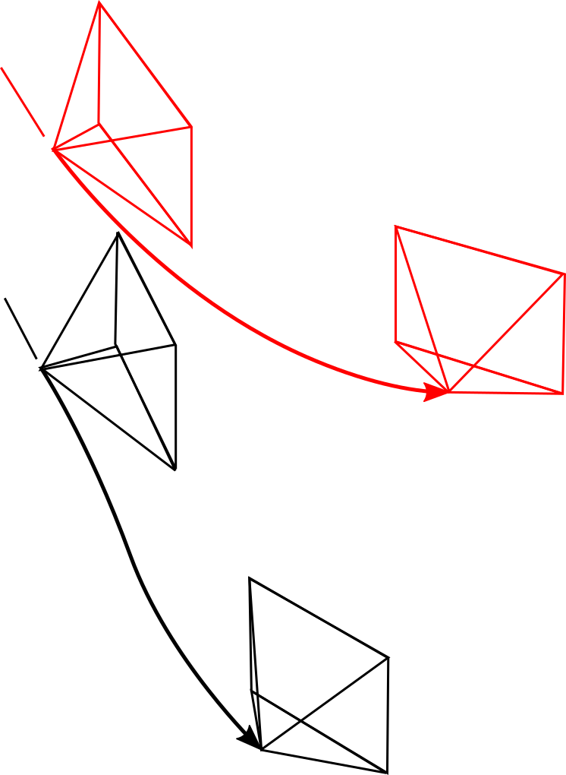
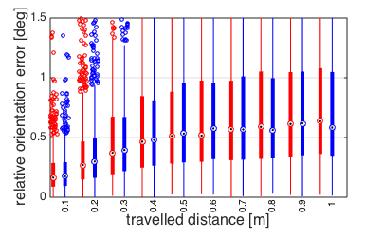
Local Accuracy

Slide 12
Results
 | Rovio | Okvis
Global Yaw Error | 45 ° / 1000 m | 4 ° / 1000 m
Global world-z Error | 1 m / 1000 m | 30 cm / 1000 m
Local Translation Error | 2 cm / 1 m | 2 cm / 1 m
Local Orientation Error | 0.6 ° / 1 m | 0.6 ° / 1 m
Processing Time / Frame | 10 ms | Unknown, higher

Slide 13
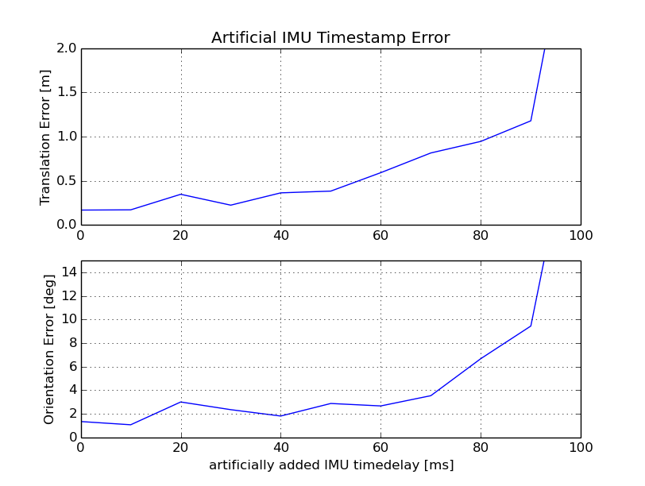
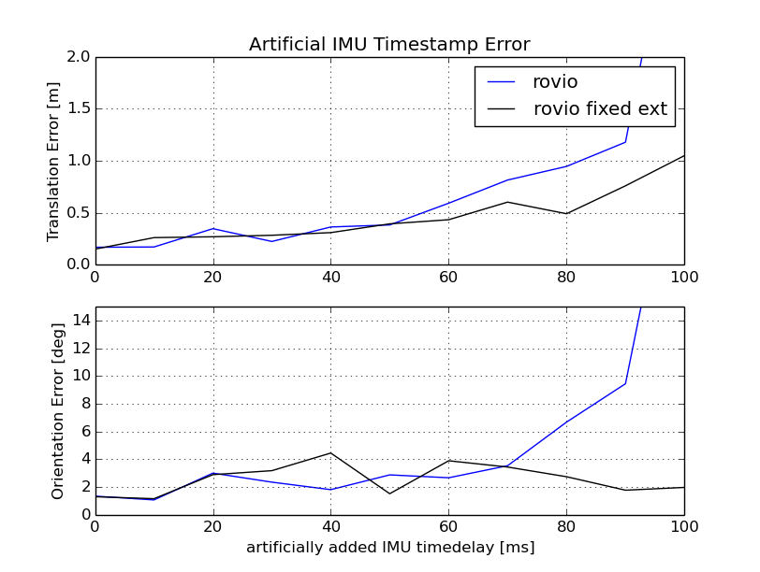
Towards non-timesynchronized Hardware 1) Analysis with artificial timedelay

Slide 14
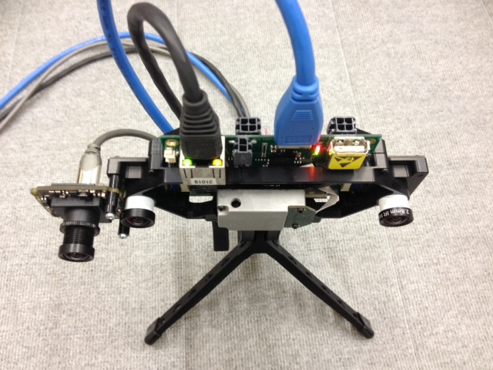
Towards non-timesynchronized Hardware Real Test
VI Sensor
Bluefox 2.0
Indoor, handheld, 60 m, 3 loops
Slow and Fast Dataset

Slide 15
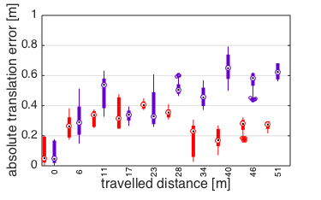
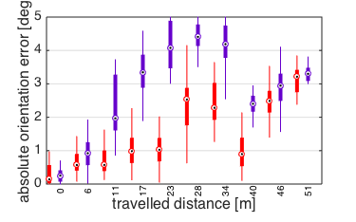
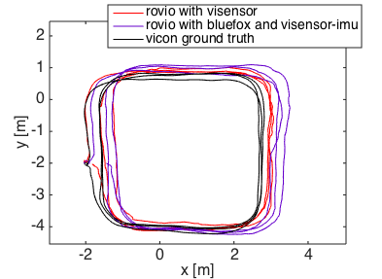
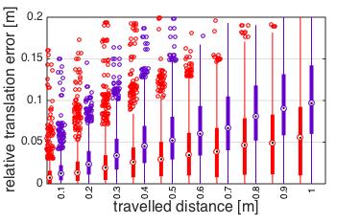
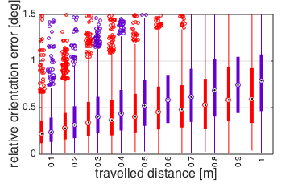
Slow Dataset
Dynamics: 1.5 m/s, 1 rad/s
Non-timesynced Hardware is able to track
Visensor performs better

Slide 16
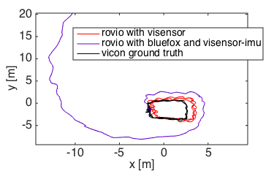
Fast dataset
Fast, shaky motions
Dynamics: ?, ?
Non-timesynced Hardware diverging

Slide 17
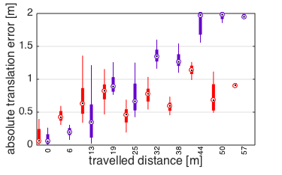
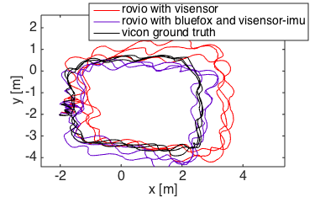
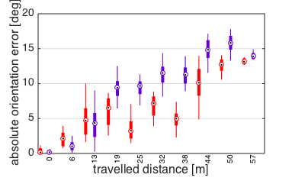
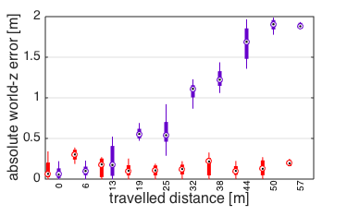
Fast dataset – Fixed Extrinsics
Fixing the Extrinsics on non-timesynced Hardware increases Rovio performance

Slide 18
Outlook
Rovio: Include additional Sensorinformation (GPS, Mag)
Rovio: Combine with „Backend“ performing a Global Optimization
Make Okvis running and evaluate
Run Rovio on Embedded system with lower-quality IMU and non-timesynchronized Hardware

Slide 19
Thank you !

Slide 20
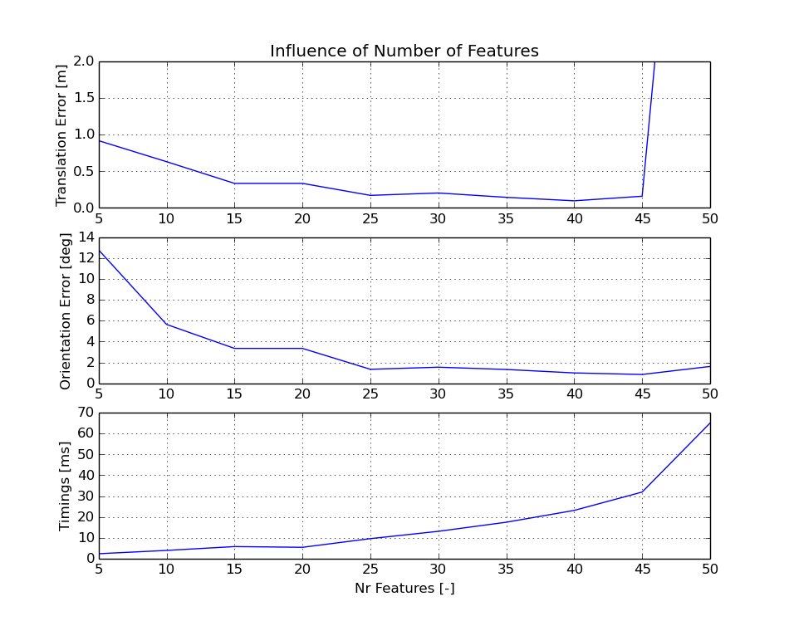
Features / Computational Complexity

Slide 21
Ev features

Slide 22
Long Trajectory

Slide 23
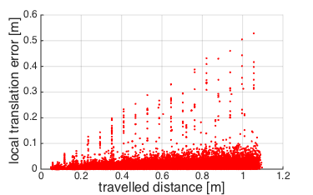
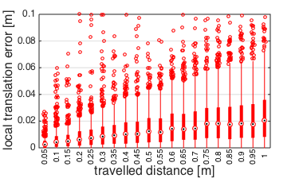
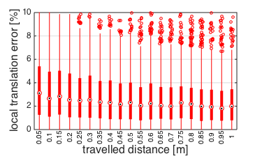
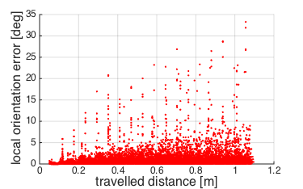
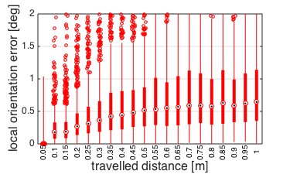
LTE = 2 cm / 1 m (2 %)
LOE = 0.6° / 1 m

Slide 24
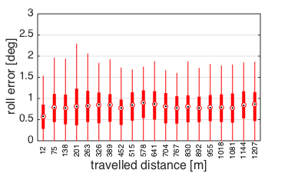
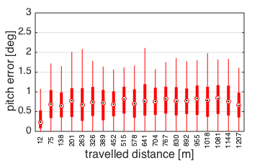
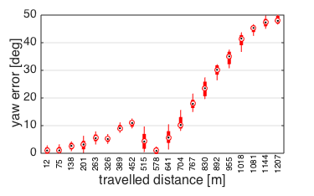
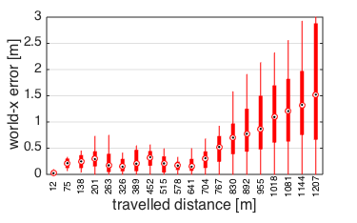
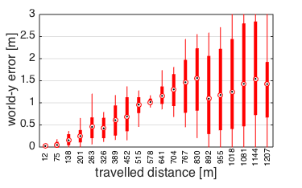
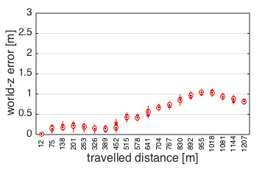
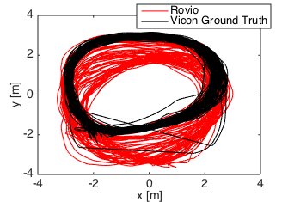
GOE_Yaw = 45 deg / 1000 m
GTE_Z = 1 m / 1000 m (0.1 %)

Slide 25
Long Trajectory: Summary (create Table!)
Local Accuracy:
LTE = 2 cm / 1 m (2 %)
LOE = 0.6° / 1 m
Global Accuracy
roll and pitch errors bounded
yaw error = 45 deg / 1000 m
x and y errors are driven by yaw
z error = 1 m / 1000 m (0.1 %)
Computational Complexity
Average Processing Time per Image = 10 ms

Slide 26
Results
Yaw-Drift of Rovio 10 Times higher than Okvis
Global Translation Error 2 Times higher than Okvis
World-z Error ? Times higher than Okvis
Locally Rovio and Okvis similar (?)

Slide 27
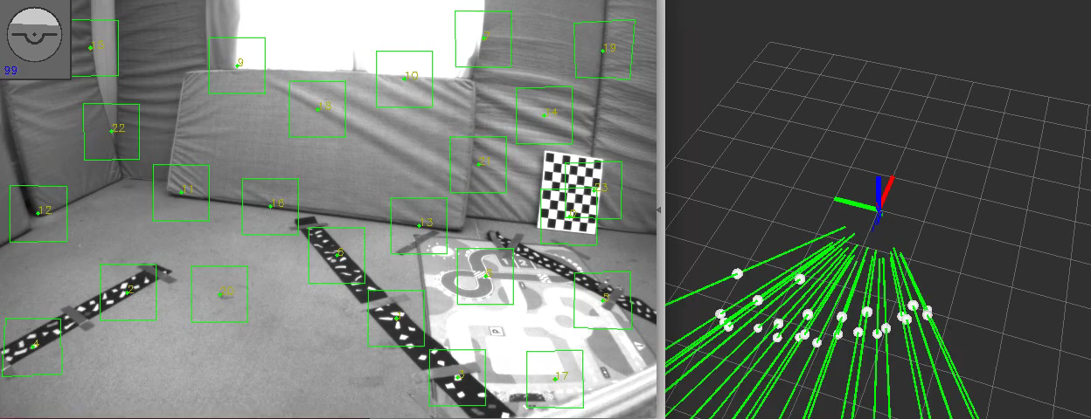
Short Trajectory

Slide 28
Evaluation Sheme
Local Accuracy
Local Translation Error
Local Orientation Error
Global Accuracy
Absolute Translation Error
Absolute Orientation Error
World-Z Error
Yaw Error
Computational Complexity
Processing Time for a new Frame

Slide 30
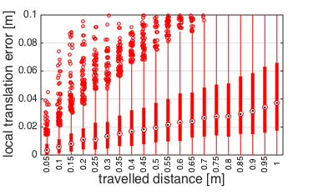
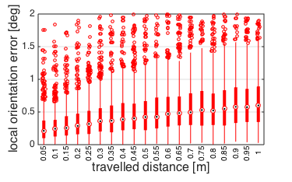
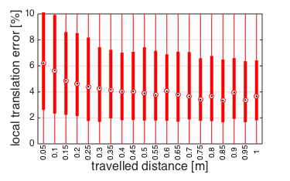
LTE = 4 cm / 1 m (4 %) LOE = 0.6° / 1 m

Slide 31


Slide 32







GOE_Yaw = 1 deg / 50 m
GTE_Z = 5 cm / 50 m (0.1 %)

Slide 33
Short Trajectory: Summary (create Table!)
Local Accuracy:
LTE = 4 cm / 1 m (4 %)
LOE = 0.6° / 1 m
Global Accuracy
roll and pitch errors bounded
yaw error = 1 deg / 50 m
x and y errors are driven by yaw
z error = 5 cm / 50 m (0.1 %)
Computational Complexity
Average Processing Time per Image = 10 ms

Slide 34



Slow Dataset – Global Accuracy
Visensor performs better
New Hardware is able to track

Slide 35


Yaw Drift
Translational Drift

Slide 37
Global Error
Thanks to gravity: Roll and Pitch Errors bounded (small)
Yaw Drift
World-X and World-Y Errors driven by Yaw Error
World-Z Drift
Local Errors cancel out → Global Error smaller than integrated local errors

Slide 39




Robot
B
C
I
J

